Slide 1
Technology-Enriched Learning Environments
Faculty Development Workshop
February 21, 2013
Donna L. Pattison, PhD
Instructional Professor
Department of Biology & Biochemistry

Slide 2

Discussion:
What are some ways technology can be integrated into a class?
  in the lecture hall
  in the teaching lab
  in outside of class assignments

Slide 3
Integrating Technology into Class
Information Seeking and Problem-Solving
2. Computerized Modeling and Simulations
3. Computer-Based Laboratories and Real-Time Graphing
4. Collaborative Learning and Knowledge Sharing

Slide 4
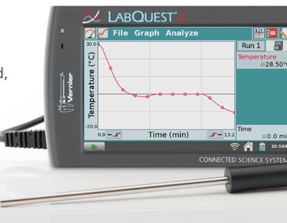
Probeware

Slide 5
Discussion:
What online resources are available that may be applicable to teaching a college biological science course?

Slide 6
Online Resources:
Tools of the Trade:
a. BLAST
b.NEBCutter
c. CLUTTO
d.SeqAlign/Tcoffee
e. FoldIt
f. Protein Database
PubMed
Online textbooks: The Arabidopsis Book
ASM: Microbiology Book, Intro Bio Book
Textbook supplemental materials
Social Media: Facebook and Twitter

Slide 7
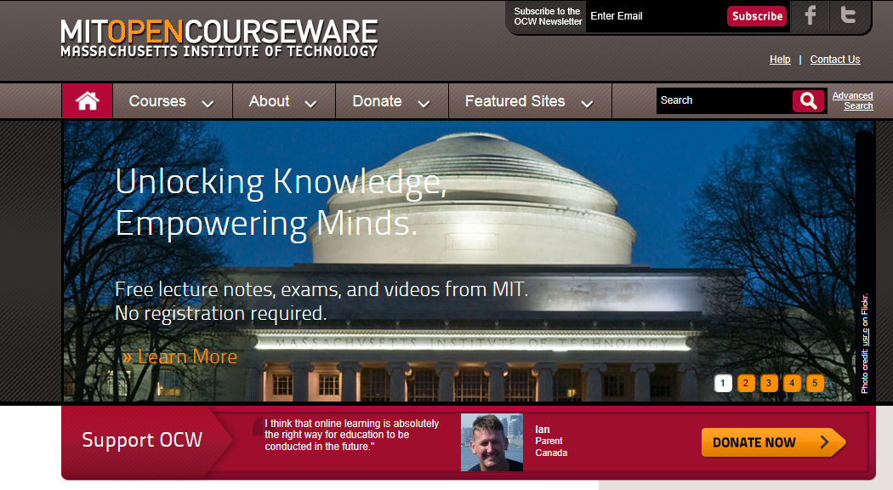
Open Courseware:

Slide 8
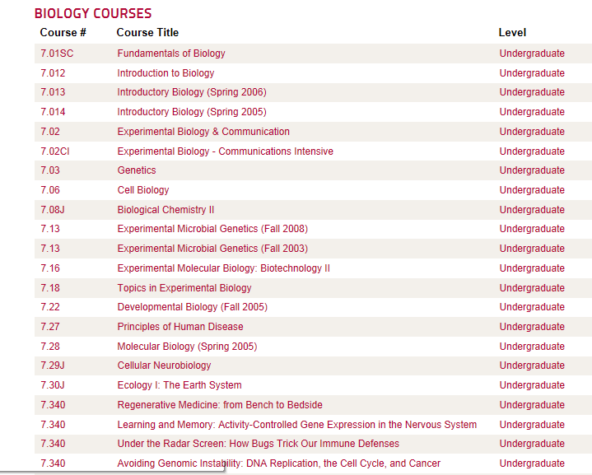
Open Courseware:

Slide 9
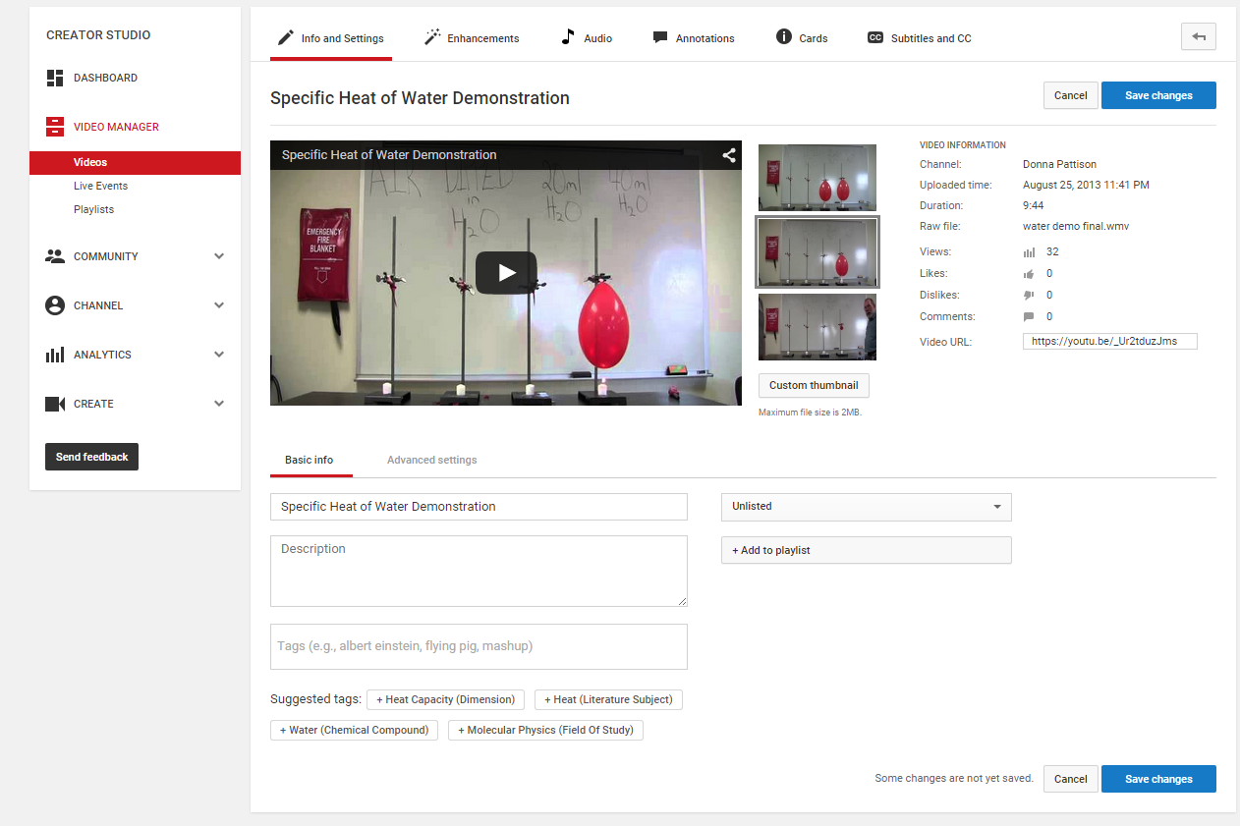
Using YouTube:
Setting options:
Public
Unlisted
Private

Slide 10
Using YouTube:
Setting options:
Public: Anyone can view it.
Unlisted: The video can only be seen by those who have the link. Anyone that is sent the link though can share with others. Video cannot be found by searching.
Private: Only those you invite to view the video can see it. They must have their own Youtube account. You can only invite up to 50 people. It cannot be shared with anyone not on the invitation list.

Slide 11
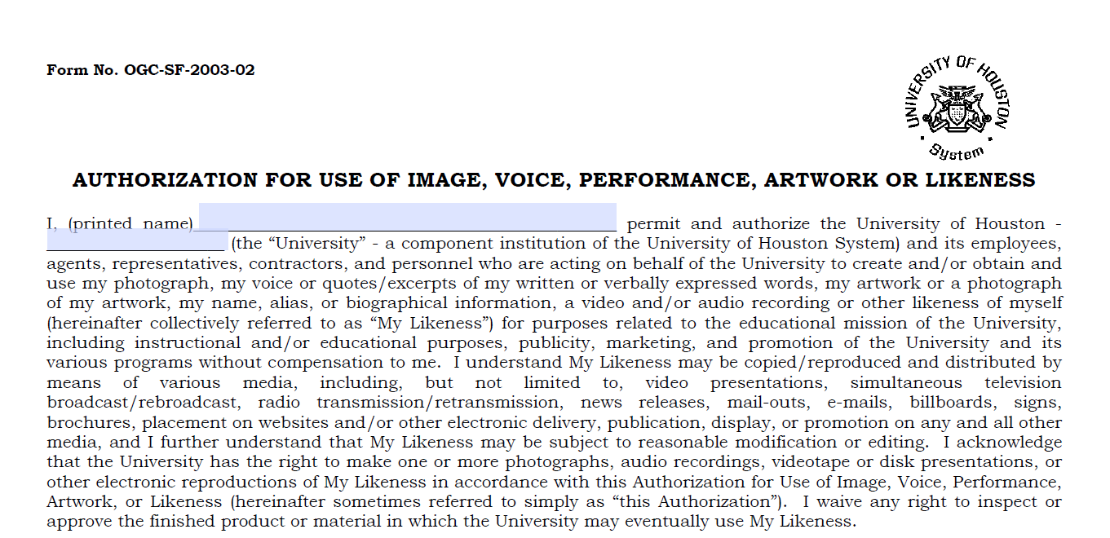
Using YouTube:
Be sure to obtain a video release consent form from all students in any video you are posting or be sure the students are not identifiable in the video! Many university legal offices (Office of the General Counsel) have a specific form you should use.

Slide 12
Blogs, Wikis, and Discussion Boards
Blog = weblog: running online journal
Wikis: interactive web page
Discussion boards: online discussion
Lay the ground rules!

Slide 13
Topic | Blog | Wiki | Discussion Board
Name origin
Focus
Control
Content type
Purpose
Organization/ Features
Voice
Design
Possible Uses
Scenarios/Reasons to Use for Teaching
Challenges
Notes:
For group discussion.

Slide 14
Threaded discussion forums…
Discussion in class.
Post questions on the web-based discussion board.
Students chose a question and post a response.
Students post at least two replies.
Pre-reading→In-class discussion→Discussion Board→Wrap-up in-class discussion

