Slide 1
Rubric Design
Faculty Development Workshop
Donna L. Pattison, PhD
Instructional Professor
Department of Biology & Biochemistry

Slide 2
Evaluate the quality of this assignment:
The assignment:
You will write a 10 page research paper on a topic from the list below. The paper should be double-spaced with 1” margins using a Times Roman font. A minimum of 10 references is required.
Systemic acquired resistance in plants vs the hypersensitive response
The role of abscisic acid in seed dormancy and germination
The role of red and blue photoreceptors in plant development

Slide 3
What is a Rubric?
Rubric: A descriptive guide, usually in the form of a matrix that provides scaled levels of achievement or understanding for a set of criteria or dimensions of quality for a given type of performance (paper, oral presentation, teamwork)
Adapted from Allen, D. and Tanner, K. (2007) Transformations: Approaches to College Science Teaching. W.H. Freeman Scientific Teaching. Chapter 7, p. 83.

Slide 4
What is the difference between a rubric and a scoring checklist?

Slide 5
What purpose does a rubric serve?
Communicate clear expectations
Aid student with self-reflection and self-evaluation of work.
Provide feedback
Evaluation: assignment level or learning outcomes across a department or university (i.e. University Core).
Criterion referenced rather than norm-referenced

Slide 6
Holistic vs Analytic Rubrics
Holistic Analytic
Provide a single score Provides a score for each
based on overall impression characteristic
Quick scoring More time consuming
Provides fast snapshot Detailed feedback

Slide 7
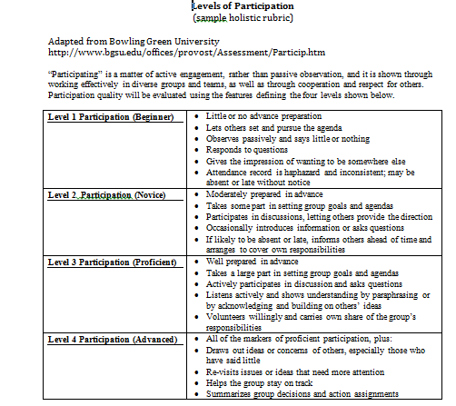
Holistic Rubric
http://manoa.hawaii.edu/assessment/howto/rubrics.htm

Slide 8
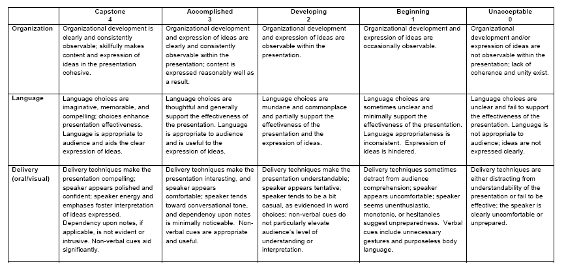
Analytic Rubric
http://cosm.sfasu.edu/docs/Rubrics/Core/FINAL%20ORAL%20AND%20VISUAL%20COMMUNICATION%20VALUE%20RUBRIC.pdf

Slide 9
Elements of a Rubric
Performance elements: major attributes on which the
work will be evaluated
Category scale: Quality classification
Descriptors: Description of the characteristics of the work that
must be present at each quality category.

Slide 10
Typical Scales
poor-good-excellent-superior
beginning-basic-proficient-advanced-outstanding
Unacceptable-developing-acceptable-exemplary
Below expectations-meets expectations-exceeds expectations
seldom-sometimes-usually-often
Rarely-sometimes-often-almost always
http://www.unk.edu/uploadedFiles/academicaffairs/Assessment/Training/Developing%20Rubrics.pdf and http://uwf.edu/cutla/rubricdevelopment.cfm ; retrieved 3/20/2014

Slide 11
Choice of Scale: 3, 4, 5, 6 levels?! What’s best?
Discussion….

Slide 12
Choice of Scale: 3, 4, 5, 6 levels?! What’s best?
There is no right answer!
Some argue that even numbered scales are best as it forces the user to select between a proficient and a not proficient level.
Others prefer an odd numbered scale because it allows for a “neutral” middle answer.

Slide 13
Steps to Developing a Rubric
Identify what you want to assess.
Identify the characteristics or dimensions (rows).
Identify the scale (columns).
Create descriptions for each characteristic and scale level.
Test rubric.
Revise.

Slide 14
No need to reinvent the wheel….
Check what’s available online and adapt it.
Use rubric builders:
http://rubistar.4teachers.org/
http://www.rubrician.com/science.htm

